Slide 1
SECURE DATA BY HIDING IN IMAGES USING STEGNOGRAPHY
SECURE THE DATA TO PREVENT HACKERS
Presented By:
Student Name : Priyanshu Tripathi
College Name & Department : Delhi Technological University- Btech ( in Computer Science and Engineering)

Slide 2
OUTLINE
Problem Statement
Technology used
Wow factor
End users
Result
Conclusion
Git-hub Link
Future scope

Slide 3
Problem Statement
Creating a two way program to convert the message into a steganography image and also decode the message at receiver using a passcode for safe and secure transmission for privacy of the head of a software inc.

Slide 4
Technology used
Platform:
Visual Studio Code (VS Code) – A powerful and flexible code editor with extensive support for Python development, debugging, and extensions.
Programming Language:
Python – A versatile, high-level programming language known for its simplicity and efficiency in various domains, including computer vision and image processing.
Library:
OpenCV (cv2) – An open-source computer vision and image processing library that provides tools for real-time image and video analysis, object detection, and more.
Operating System - Compatible with various OS environments, including Windows, macOS, and Linux, ensuring flexibility in development and deployment.

Slide 5
Wow factors
What makes this project stand out from other project(Unique features)
It uses incremental encoded message which help in safe case if steganography didn’t safeguard our information ( for example, ABC is saved as BCD in image).
We are CV2 Library to store the message in the image.
It also uses the passcode given by the sender to store it in the image by having the numerical value have an increment of password % 17.
It uses all the three colour set RGB that make us to have total words to store up to (total pixel *3) but as we use to leave pixel at a value of password % 23. So it varies every time.

Slide 6
End users
The end users are the head of a software company to have a secure discussion over the clarification and security code for the file.
These end users could be – Software Engineers, Managers, Team Head, Data Scientist, CEO and also the executives of the company.
The Company for which we are making this project are – IBM, and many more.

Slide 7
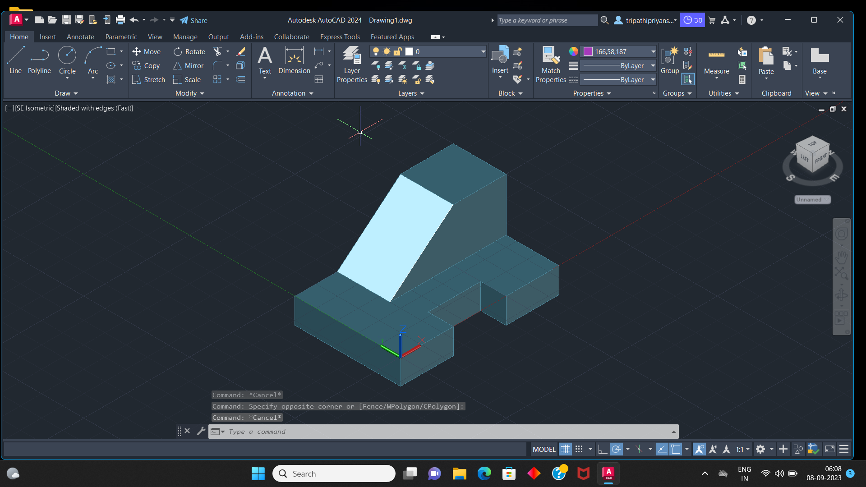
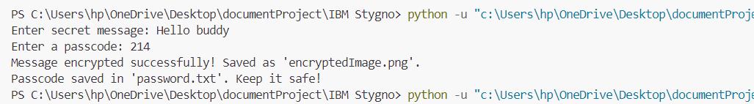

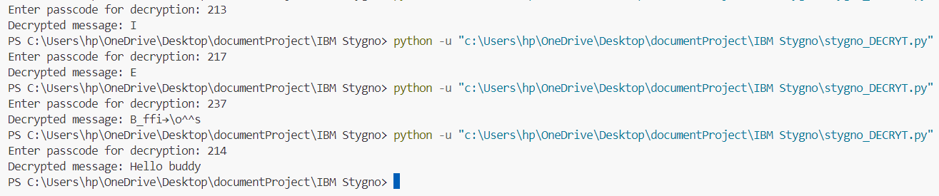
Results
Steganography –
Encoder
Decoder
Original Image – 293 kb
Encrypted Image – 522 kb

Slide 8
Conclusion
This project is totally safe for its user.
It requires pre instalment of Python and CV2 Library for its working.
This project uses Steganography to encrypt and decrypt the message in an image.
It involves two code for encoding (stygno_ENCRYT.py) and decoding (stygno_DECRYT.py).
By using this we can encode an image and decode it to get the desired message using the correct passcode. (!!Note: Passcode Should be in numeral form)

Slide 9
GitHub Link
https://github.com/Priyanshu00700/IBM_Stygnography

Slide 10
Future scope(optional)
We know computer systems are becoming faster and could crack any password. So, we could use quantum key to encrypt the message before using steganography as q-bit follow no cloning theorem and prone for any data leak as it could tell beforehand if anyone is between the sender and receiver and is trying to take the data.
By using this we be able to talk between two government bodies without any data leak.
This increment could also make any kind of misunderstanding away as it would be safest for both sides.
In a company it could help in any kind of project leak which leads to decrease in stock prises and loss in deployment of it. (for ex, Rockstar Games faced significant financial and security challenges after the GTA 6 leak, including a 6% drop in stock value, potential development disruptions, and increased cybersecurity costs, but assured fans that the game’s release remained on track.)

Slide 11
THANK YOU

